Slide 1




FlyingWhale Airline Business Intelligence Presentation
This presentation provides a comprehensive analysis of FlyingWhale Airline's business intelligence, highlighting key findings, trends, and actionable recommendations.
by Khola Shams

Slide 2
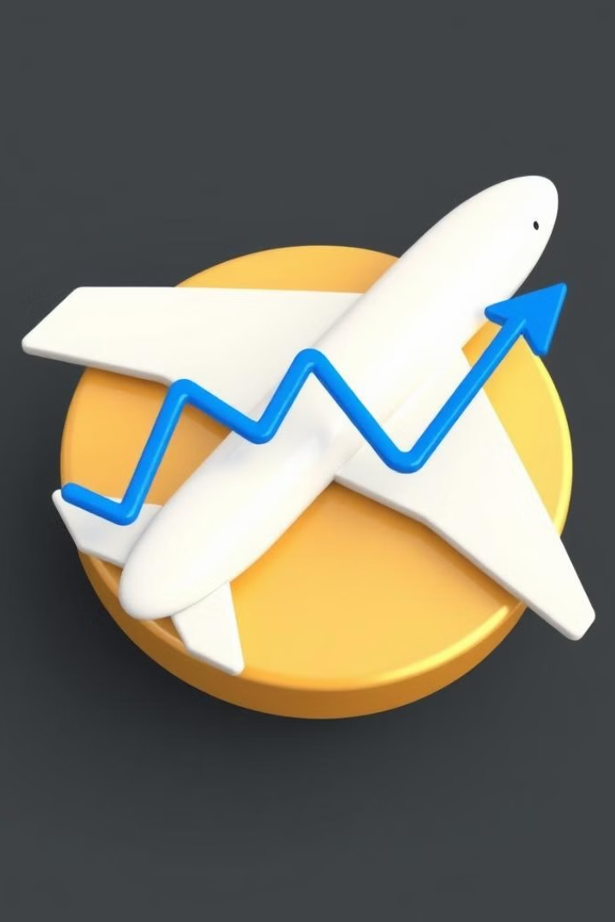
FlyingWhale Airline Business Intelligence Analysis
Prepared for
FlyingWhale Airline Management
Prepared by
Khola Shams
Date
06-10-2024

Slide 3
Table of Contents
Executive Summary
Key Findings
Flight Activity Analysis
Loyalty Program Segmentation
Enrollment & Cancellation Trends
Recommendations
Conclusion

Slide 4

Executive Summary
1
Peak Booking Month
2
Loyalty Program Insights
July witnessed the highest flight activity, particularly in 2017 and 2018.
Star loyalty card holders are the most engaged, while Nova and Aurora tiers show potential for improvement.
3
Cancellations
4
Companion Travel Impact
A significant increase in cancellations was observed in December, August, and November.
High loyalty point redemption occurs with group bookings, especially for larger groups.

Slide 5
Key Findings - Flight Activity
Peak Booking Month
Flight Distance & Points
July, with a total of 246,298 flights.
A positive correlation exists between flight distance and loyalty points accumulated.
Star: 112,219 flights
Nova: 81,772 flights
Companion bookings significantly increase points redeemed.
Aurora: 51,307 flights

Slide 6
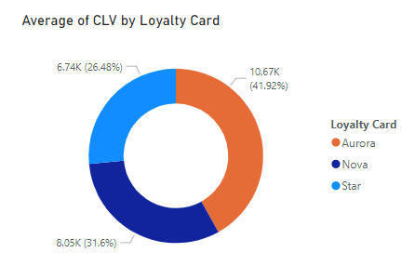
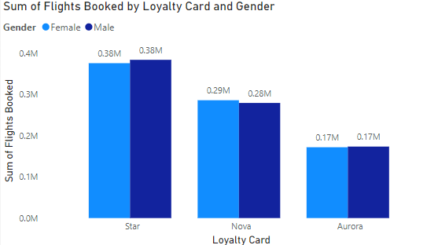
Key Findings - Loyalty Program Segmentation
Highest Activity
Star cardholders
Gender Insights
Total Flights: Males: 836,166, Females: 832,998
Star Card Disparity
Males booked 8,098 more flights than females
Customer Segments
Married individuals and bachelor students constitute the largest share of loyalty program members.

Slide 7
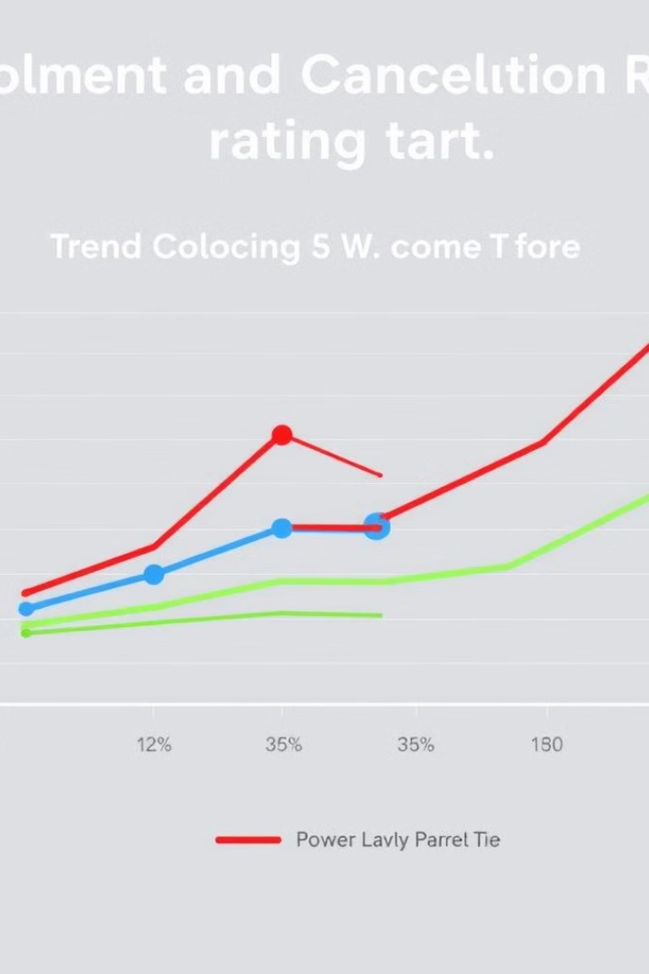
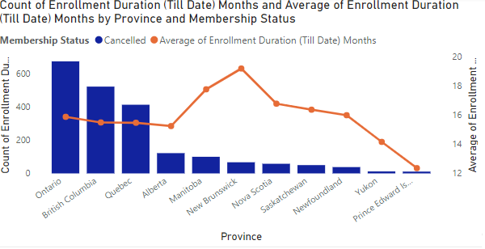
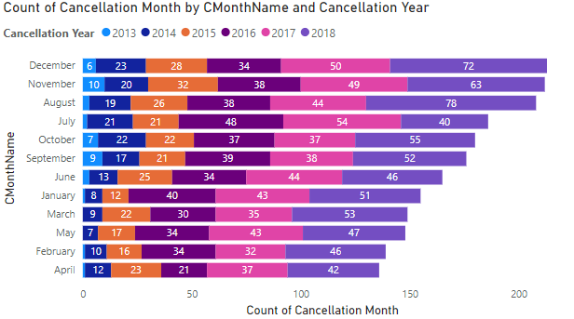
Key Findings - Enrollment & Cancellation Trends
1
Cancellations by Month
Highest in December, August, and November.
2
Provincial Trends
New Brunswick has the longest average enrollment duration (19.20 months).
3
Demographic Cancellations
Married individuals and bachelor students have the highest cancellation rates.

Slide 8




Recommendations - Loyalty Program Enhancements
Target Nova & Aurora Tiers
Group Travel Promotions
Gender-Specific Campaigns
Offer tailored benefits to increase engagement and retention.
Leverage companion bookings by promoting group travel discounts and additional point redemption offers.
Focus on increasing female engagement, especially for the Star loyalty tier.

Slide 9

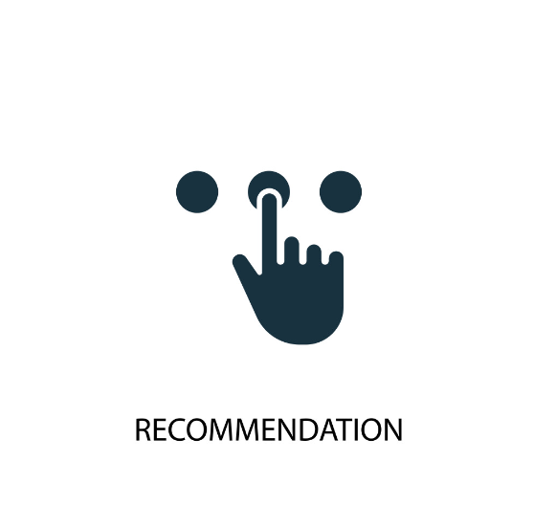



Recommendations - Customer Retention
Address Peak Cancellations
Implement retention initiatives during December, August, and November.
Personalized Strategies
Focus on value-added services for married individuals and bachelor students, who have high cancellation rates.
Regional Retention
Replicate successful retention strategies from New Brunswick in other provinces.

Slide 10


Recommendations - Improve Customer Experience
1
Service Quality Enhancements
Invest in customer service and experience improvements to drive satisfaction.
2
Communicate Program Benefits
Regularly update customers on loyalty benefits and offer personalized rewards.

Slide 11
Thank You!

